Slide 1
Search Engines for the Web
000 Dik Lun LEE Department of Computer Science, HKUST Slide <number>

Slide 2
Benefits of Using Links
Basic assumption: when two web pages are linked together, there must be some relationship or similarity between them
Links may be used to estimate similarity between web pages which are otherwise unrelated according to term-based similarity
  Links may return pages which don’t contain the query words or don’t contain the query words frequent enough to be retrieved by term-based ranking methods
Ranking based on terms alone is problematic. Consider http://www.ust.hk/
  No mention of HKUST (in text form) in page body, contained HKUST once and “Hong Kong University of Science and Technology” twice in metatags
  The main (content) frame contains HKUST twice, and “Hong Kong University of Science and Technology” once in text form and once as a GIF file
  This page will not likely be retrieved using keywords alone
000 Dik Lun LEE Department of Computer Science, HKUST Slide <number>

Slide 3
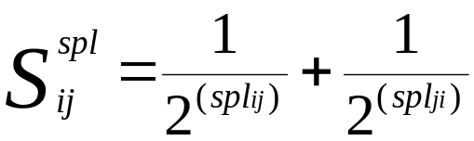
HyPursuit at MIT (1996)
Direct Path: Similarity between two documents varies inversely with the shortest path length (spl ) between the two documents.
x
j
Shortest path from j to i
Shortest path from i to j
000 Dik Lun LEE Department of Computer Science, HKUST Slide <number>

Slide 4
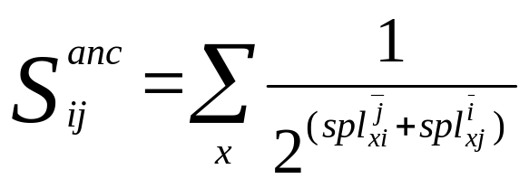
HyPursuit at MIT (1996)
Common Ancestor: Similarity between two documents is proportional to the number of common ancestors of the two documents.
i
x
j
Shortest path from x to j without
passing through i
Shortest path from x to i without
passing through j
000 Dik Lun LEE Department of Computer Science, HKUST Slide <number>

Slide 5
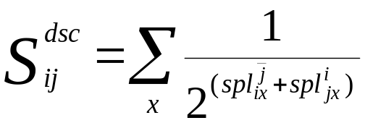
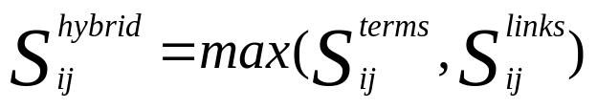
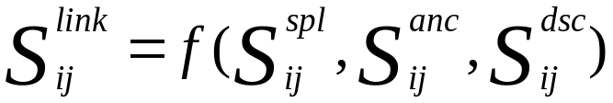
HyPursuit at MIT (1996)
Common Descendants: Similarity between two documents is proportional to the number of common descendants of the two documents.
Term-based similarity: same as vector space model with inverse document frequency ignored and the addition of attribute weights.
where x is a common descendant of i and j
i
x
j
Combine link and term similarity. E.g. taking the maximum of the similarities.
Very adhoc
000 Dik Lun LEE Department of Computer Science, HKUST Slide <number>

Slide 6
HyPursuit’s Retrieval Effectiveness
HyPursuit measures the similarity between pages, so it is NOT DIRECTLY usable in ranking algorithms
It is evaluated by measuring how well it puts similar pages together (i.e., clustering), not by measuring the quality of retrieval results
No precision and recall results
The algorithms were used to classify 195 documents from http://www.cnn.com; complete-link clustering method was used.
The computed classes and the manually assigned CNN classes are compared.
Clustering using both term and link information gives “reasonably well” results.
CNN “Standard” or “Perfect” Clusters
Hypersuit generated Clusters
Hypersuit
Sports
How to calculate precision and recall?
Basket ball
NBA
000 Dik Lun LEE Department of Computer Science, HKUST Slide <number>

Slide 7
WWW Index and Search Engine (WISE)
Conducted at HKUST in 1995, see reference papers:
  WISE: A World Wide Web Resource Database System.
  Search and Ranking Algorithms for Locating Resources on the World Wide Web
HyPursuit’s term-based and link-based similarities are independent to each other; in WISE links are used to pass term-based similarity from one page to another
000 Dik Lun LEE Department of Computer Science, HKUST Slide <number>

Slide 8
Spreading Activation in WISE
A query term found on a page contributes c₁ to the score of the page and c₂ to the scores of all pages pointed at by the page. Typically c₂ << c₁
Weighting can be binary or based on tf*idf
a
Score = 2 * C₂
Q = a, b, c
c
b
Score = 1 * C1 + 2 * C₂
Score = 2 * C₁
000 Dik Lun LEE Department of Computer Science, HKUST Slide <number>

Slide 9
Most-Cited in WISE
The score of a page equals to the number of query terms found in the pages pointing at it
Frequency information is ignored
Q = a, b, c
a
c
b
Score = 3
000 Dik Lun LEE Department of Computer Science, HKUST Slide <number>

Slide 10
Retrieval Effectiveness of WISE
Test collection was obtained by taking a snapshot of cuhk.hk on April 26, 1995; 2393 WWW pages were downloaded into the test collection. cuhk.hk was chosen for the diversity of the contents
Test queries: 56 pages from the collection was randomly selected; for each page, a query was constructed manually that was judged to be the best for retrieving that page (a subjective judgement)
The relevance of the retrieved pages was determined by human examination of the pages
000 Dik Lun LEE Department of Computer Science, HKUST Slide <number>

Slide 11
Problems with HyPursuit and WISE
Use links to estimate similarity between web pages but do not capture the most important difference between web-based and traditional document retrieval. What is the difference?
In a traditional document collection (e.g., technical reports produced by a university, legal news and articles collected by a library), the documents are of high quality
On the web, documents are of wide range of quality and authoritativeness. Consider the homepage of HKUST and a composition written by a primary school student on “My dream is to study at HKUST”
No theoretical/systematic ways of setting the link-based weighting formula (WISE is better than HyPursuit, but still not enough)
000 Dik Lun LEE Department of Computer Science, HKUST Slide <number>

Slide 12
Google PageRank
000 Dik Lun LEE Department of Computer Science, HKUST Slide <number>
Notes:
- watch for relational database engine
- phrase not supported in Lycos, OK for small collection but not for internet
- control of spiders important for internet/portals

Slide 13
Google (http://google.com)
A large-scale search engine developed at Stanford University
Make use of the additional structure present in hypertext to provide much higher quality search results
  Page Rank
  Anchor Text
It has location information for all hits and so it makes extensive use of proximity in search
It keeps track of some visual presentation details such as font size, such that words in a larger or bolder font are weighted higher than other words
S. Brin and L. Page “The Anatomy of a Large-Scale Hypertextual Web Search Engine,” Proceedings of the WWW7 Conference, 1998
http://www7.scu.edu.au/programme/fullpapers/1921/com1921.htm
000 Dik Lun LEE Department of Computer Science, HKUST Slide <number>
Notes:
- watch for relational database engine
- phrase not supported in Lycos, OK for small collection but not for internet
- control of spiders important for internet/portals

Slide 14
Google’s PageRank
It is derived from academic citation literature, in which the impact of a paper is judged by how many papers written by other people cite the paper
Citation corresponds to people's subjective judgement of importance
On the web, the number of inbound links of a page relates to the page's importance/quality, which determines the page’s PageRank
Intuitive justification
  pages that are well cited from many places are worth looking at
  pages that have citation from something like Yahoo are generally worth looking at
Not easy to spam, since spammers can’t control citations
000 Dik Lun LEE Department of Computer Science, HKUST Slide <number>
Notes:
- watch for relational database engine
- phrase not supported in Lycos, OK for small collection but not for internet
- control of spiders important for internet/portals

Slide 15
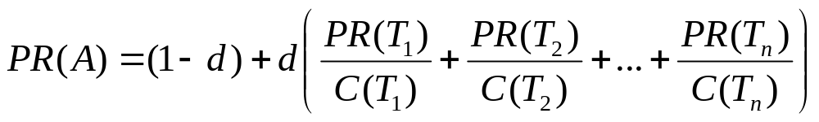
Google’s PageRank Calculation
C(T₁)
Suppose page A has pages T₁ ... T_{n} pointing to it
C(x) is the number of links going out of page x
The PageRank of page A is:
T₁
A
T₂
•••
T_{n}
  d is a damping factor which can be set between 0 and 1
  A page will get high score if it has many very important pages pointing only to it
PageRank can be calculated using a simple iterative algorithm
How to determine the initial PageRank for all pages?
Make them all 1’s or 1/n (n: number of pages)
000 Dik Lun LEE Department of Computer Science, HKUST Slide <number>
Notes:
- watch for relational database engine
- phrase not supported in Lycos, OK for small collection but not for internet
- control of spiders important for internet/portals

Slide 16
Example
d = 0.85
0.15 + 0.85(2.275)=2.084
0.15 + 0.85(1/1)=1
0.15 + 0.85(1/2)=0.575
A
1
B
1
0.15 + 0.85(1/2)=0.575
A
1
B
0.575
0.15
0.15
C
1
D
1
D
0.15
C
2.275
0.15 + 0.85(1/2+1+1)=2.275
0.15 + 0.85(1/2+0.575+0.15)=1.191
PR(A) = (1-d) + d × (PR(T1)/C(T1) + ... + PR(Tn)/C(Tn))
000 Dik Lun LEE Department of Computer Science, HKUST Slide <number>
Notes:
- watch for relational database engine
- phrase not supported in Lycos, OK for small collection but not for internet
- control of spiders important for internet/portals

Slide 17
Example
0.15 + 0.85(1.191)=1.162
A
2.084
B
0.575
0.15 + 0.85(2.084/2)=1.036
A
1.162
B
1.036
D
0.15
0.15
C
1.652
D
0.15
C
1.191
0.15 + 0.85(2.084/2+0.575+0.15)=1.652
20th iteration
A
1.490
B
0.783
C
1.577
D
0.15
PR(A) = (1-d) + d × (PR(T1)/C(T1) + ... + PR(Tn)/C(Tn))
000 Dik Lun LEE Department of Computer Science, HKUST Slide <number>
Notes:
- watch for relational database engine
- phrase not supported in Lycos, OK for small collection but not for internet
- control of spiders important for internet/portals

Slide 18
Google’s Ranking based on Anchor Text
In addition to associate the text of a link with the page that the link is on, it is also associated with the page the link points to
Advantages
  Anchors often provide more accurate descriptions of web pages than the pages themselves (and it is often written by independent objective authors)
  anchors may exist for documents which cannot be indexed by a text-based search engine, such as images, programs and databases
Disadvantage
  Since it is possible to return web pages which have not actually been crawled, so the returned web pages may never actually existed
000 Dik Lun LEE Department of Computer Science, HKUST Slide <number>
Notes:
- watch for relational database engine
- phrase not supported in Lycos, OK for small collection but not for internet
- control of spiders important for internet/portals

Slide 19
Google’s Ranking based on Hit Lists
For each word, a hit list records position, font, and capitalization information of the word in a document
Two types of hits are defined
  Fancy hits include hits occurring in a URL, title, anchor text, or meta tag
  Plain hits include hits occurring in everything else
000 Dik Lun LEE Department of Computer Science, HKUST Slide <number>
Notes:
- watch for relational database engine
- phrase not supported in Lycos, OK for small collection but not for internet
- control of spiders important for internet/portals

Slide 20
Google’s Performance
Results returned by Google are clustered by server
Without any optimization such as query caching, subindices on common terms, Google can still answer most queries in between 1 and 10 seconds
Google has shown to produce better results than the major commercial search engines for most searches, for instance most major commercial search engines do not return any results from whitehouse.gov when a search for "bill clinton" is issued
000 Dik Lun LEE Department of Computer Science, HKUST Slide <number>
Notes:
- watch for relational database engine
- phrase not supported in Lycos, OK for small collection but not for internet
- control of spiders important for internet/portals

Slide 21
Problems with Google’s PageRank
It favors big ($$$) websites that can afford to put their links all over the web to be ranked on the top
Little web sites with rich content but with only a few or even no links pointing to may never be seen by the user (discovery issue)
Favors general web sites
There are always exceptions:
  Having more inbound links doesn't necessarily implies the relevancy of a page
  Being pointed by an important (high PageRank) site doesn't necessarily implies the relevancy of a page
  A page points to another page for many reasons
000 Dik Lun LEE Department of Computer Science, HKUST Slide <number>
Notes:
- watch for relational database engine
- phrase not supported in Lycos, OK for small collection but not for internet
- control of spiders important for internet/portals

Slide 22
Other Aspects / Applications of PageRank
000 Dik Lun LEE Department of Computer Science, HKUST Slide <number>

Slide 23
The Rank Sink Problem
When two pages pointing to each other but not to any other pages, their PageRank values will increase indefinitely
Initial version of PageRank does not have damping factor:
PR(A) = (PR(T1)/C(T1) + ... + PR(Tn)/C(Tn)) and causes problem!
PR_{i}(A) = Pr_{i-1}(B) + PR_{i -1}(C)
PR_{i}(B) = PR_{i -1}(A)
PR(C) varies, depending on the other pages that C is connected to
But as long as PR(C) remains positive, PR(A) and PR(B) will increase indefinitely; B serves as a temporary storage for A’s previous PR value.
The damping factor d depreciates the PR values in the loop
C
A
B
PR_{i-1}(C)
PR_{i-1}(A)
PR_{i-1}(B)
PR_{i}(A) =
PR_{i-1}(B) +
PR_{i-1}(C) =
PR_{i-2}(A) +
PR_{i-1}(C)
PR_{i}(B) =
PR_{i-1}(A)
PR_{i}(C)
000 Dik Lun LEE Department of Computer Science, HKUST Slide <number>
Notes:
- watch for relational database engine
- phrase not supported in Lycos, OK for small collection but not for internet
- control of spiders important for internet/portals

Slide 24
The Random Surfer Model
Link structure determines browsing behavior
PageRank(A) is the probability that a surfer is at page A at a given time.
What will bring a surfer to a page?
  The user jumps to a page with probability d by typing in the URL of that page (this is called “teleporting”)
  The user follows a link from the page that he is visiting
  Assuming that the user will not use the back or forward buttons
Probability to visit A directly is d
Probability to visit A by following a link from a parent is
  PR(T₁) : probability that user is at T₁
  PR(T₁)/C(T₁) : probability that user clicks the link connecting to A
Random surfer model reflects the dynamic of users
  How can you incorporate the dwell time of a user on a page?
T₁
T₂
A
•••
T_{n}
000 Dik Lun LEE Department of Computer Science, HKUST Slide <number>
Notes:
- watch for relational database engine
- phrase not supported in Lycos, OK for small collection but not for internet
- control of spiders important for internet/portals

Slide 25
Matrix Notation
T₁
T₂
A
Forget about the damping factor for a moment (d=1)!
•••
A vector of PR values for all n pages in the k^{th} iteration:
PR_{(k)}^{T} = [PR_{(k)}(P₁), PR_{(k)}(P₂), …, PR_{(k)}(P_{n})]
PR_{(k+1)}^{T =} PR_{(k)} H
H is the link matrix
h_{i,j} = 1/|P_{i}| if i → j
= 0 otherwise
|P_{i}| is the number of links pointing out from i (i.e., C(T_{i}) in PR formula)
PR converges to the eigenvector for H
T_{n}
PR does not converge when there are dangling nodes
Solution:
Replace zero rows with [1/n, 1/n, … 1/n]
Google: add a damping factor (teleporting)
000 Dik Lun LEE Department of Computer Science, HKUST Slide <number>
Notes:
- watch for relational database engine
- phrase not supported in Lycos, OK for small collection but not for internet
- control of spiders important for internet/portals

Slide 26
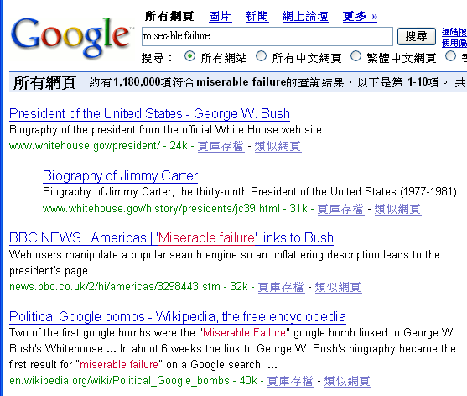
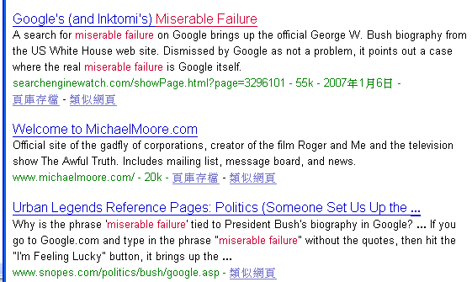
Google Bomb – Link Spamming
Screen captured on Jan 8, 2007
(spamming was reported since 2003; why didn’t Google “fix” it? It was fixed sometimes in Feb 2007)
000 Dik Lun LEE Department of Computer Science, HKUST Slide <number>

Slide 27

A search on “weapon of massive destruction” return the above page at #1 rank for a few months in the middle of 2003. Google has since “fixed” it. The “404” page was (and still is) hosted at http://www.coxar.pwp.blueyonder.co.uk/
000 Dik Lun LEE Department of Computer Science, HKUST Slide <number>

Slide 28
Link Boosting
Large sites have higher total page ranks
Given the same content, split the content on as many pages as possible
000 Dik Lun LEE Department of Computer Science, HKUST Slide <number>

Slide 29
Link Boosting (Cont.)
Limit the number of links to other websites to avoid PageRank leaks (Why?)
If you must have the external out-links, place the links on pages with a large number of internal out-links
Which of A, B or C leaks the least (or the most) PageRank?
A
B
C
000 Dik Lun LEE Department of Computer Science, HKUST Slide <number>

Slide 30
Link Boosting (Cont.)
Avoid sinks
  Users are forced to leave your sites
  And Google can easily detect sinks and remove them from its index
Add links to break the sink
A
A
A
B
B
B
C
C
C
000 Dik Lun LEE Department of Computer Science, HKUST Slide <number>

Slide 31
PageRank: Standing on the Shoulders of Giants
Brin and Page [1998] were NOT the first to compute the importance of an object iteratively
Kleinberg [1998]: rank web pages by authority and hub weights (to be covered later)
Gabried Pinski and Francis Narin [1976]: rank the importance of journals by the number of citations they receive and the importance of the citing journals (impact factor of a journal)
Charles Hubbell [1965]: rank importance of individuals based on the importance of the people who endorse them
Wassily Leontief [1941]: rank importance of an economic sector by the importance of the sectors that supply it
  Leontief received the 1973 Nobel Prize in economics for this work
000 Dik Lun LEE Department of Computer Science, HKUST Slide <number>

Slide 32
Why is the Spider Important?
The spider determines the quality of your information source
and it is difficult to do it well ...
Running a web crawler is a challenging task…. Crawling is the most fragile application since it involves interacting with hundreds of thousands of web servers and various name servers which are all beyond the control of the system.
Sergey Brin and Lawrence Page, Google Designers
Google won Webby Awards, 2000: http://www.webbyawards.com/
Try some queries: ibm, white house, Dik Lee, etc., and compare results with Altavista
000 Dik Lun LEE Department of Computer Science, HKUST Slide <number>

Slide 33
Comparisons of Hypursuit, WISE and PageRank
Hypursuit | WISE | Google
interprets a link as an indication on the similarity between the connected pages | Interprets a link as an indication on the similarity between the connected pages | Interprets a link as a vote on the authority or quality of the page
Similarity between pages can be computed offline | Similarity is computed between a query and the pages and thus must be computed online | PageRank is dependent only on the Web graph and thus can be computed offline
Link-based similarity is independent of page content | Similarity is based on page content | PR is independent on page content
Similarity is between pages and thus is query independent | Similarity is query dependent | PR is query independent
000 Dik Lun LEE Department of Computer Science, HKUST Slide <number>

Slide 34
Notes about PageRank
PR is query independent, i.e., whether the query is “music” or “politics”, the PRs of the pages retrieved are constant.
  Results for all kinds of queries appear to be good on Google because the queries filter out the pages containing the query keywords (thus they are relevant to the queries to some degree) and PR does the ordering
  It sounds simple, but it works!
Google needs to maintain only ONE table containing the PR values of the 20+ billion pages indexed
Rumour has it that Google updates the PR table once a month, leading to the “Google dance” phenomenon
000 Dik Lun LEE Department of Computer Science, HKUST Slide <number>

Slide 35
Extensions of PageRank
Topical PageRank: A page may have a high PageRank because it is an authoritative page on investment but it may not be an authoritative page on entertainment, etc.
The Web graph should be segmented by subject, e.g., one sub-graph for entertainment, and then PR values are computed within the sub-graph.
Random surfer: In the PR formula (i.e., random surfer model), every page has equal probability (as defined by d) for direct visit (i.e., not by following links but by direct entering URL or bookmarks), this is not true in real life. To deal with the difference, every page should have its own d value:
PR(A) = (1-d(A)) + d(A)(… …)
d(A) has to be estimated from bookmarks and web server logs, but unfortunately these things are not available in public
000 Dik Lun LEE Department of Computer Science, HKUST Slide <number>

